Slide 1
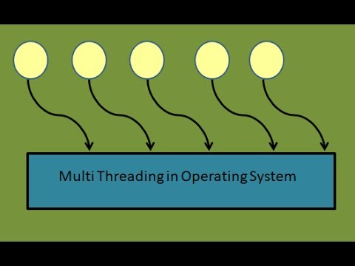
PoSync
Project on Thread Synchronization
TEAM MEMBERS: Preeti Krishnan
Sandyarathi Das
Saranya Mohan
Shruthi Narayanan

Slide 2

Problem Statement
A Teaching Assistant (TA) in Computer science department
Helps graduate students during regular office hours.
Has a office room with a chair and computer
Wait room with 5 waiting chairs available for students to wait
TA addresses students’ queries
When no students are waiting, TA sleeps
Conditions :
During office hours, the student informs the TA and asks for help.
If TA is helping a student, other students wait using one of the chairs in waiting room.
If no waiting chair available, student leaves

Slide 3
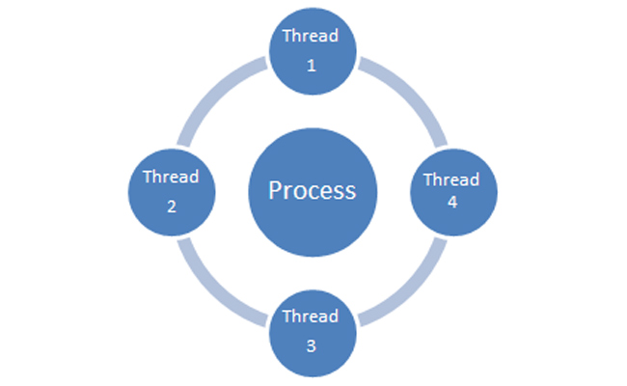
Purpose
Understand the concepts of Multi-threading and thread synchronization
Parallel or concurrent threads
shared data
Integrity of the data
Critical section problem
Solution
POSIX Pthreads
Single TA & Multiple TA problem

Slide 4
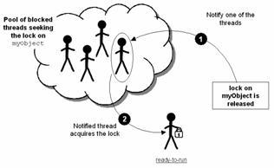
Process Synchronization
Synchronization
mechanisms to ensure concurrently executing processes/threads does not result in data inconsistency
avoid race condition
mutual exclusion
Synchronization must also guard:
Busy Waiting
Deadlocks
Starvation

Slide 5
Process Synchronization
Semaphores
No busy waiting
Semaphore S – integer variable
Two standard operations modify S: wait() and signal()
Less complicated
Can only be accessed via two indivisible (atomic) operations
Semaphore Types:
Counting semaphore – integer value can range over an unrestricted domain
Binary semaphore – integer value can range only between 0 and 1 (mutex locks)
Can implement a counting semaphore S as a binary semaphore
Provides mutual exclusion

Slide 6
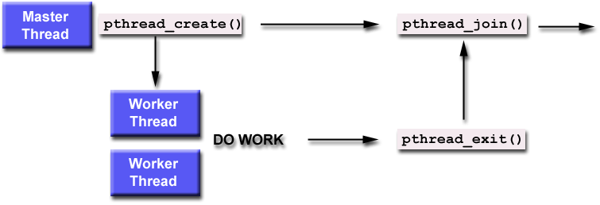
Pthreads
POSIX Threads→ Pthreads
POSIX thread libraries are a standards based thread API for C/C++.
Implemented with pthread.h header + thread library
Pthreads procedures → prefixed with "pthread_” (ex. pthread_create)

Slide 7
PTHREAD_CREATE & PTHREAD_JOIN
pthread_create (pthread_t *thread, pthread_attr_t *attr, void *(*start_routine)(void *), void *arg)
pthread_create creates a new thread and makes it executable. This routine can be called any number of times from anywhere within our code.
int pthread_join (pthread_t th, void **thread_return)
The pthread_join() subroutine blocks the calling thread until the specified thread terminates..

Slide 8
SEMAPHORE ROUTINES
A semaphore is as an object with an integer value that we can manipulate with two routines to follow the POSIX standard: sem_wait() & sem_post()
int sem_init(sem_t *sem, int pshared, unsigned value);
int sem_wait(sem_t *s)
{
wait until value of semaphore s is greater than 0
decrement the value of semaphore s by 1
}
int sem_post(sem_t *s)
{
increment the value of semaphore s by 1
if there are 1 or more threads waiting, wake 1
}

Slide 9
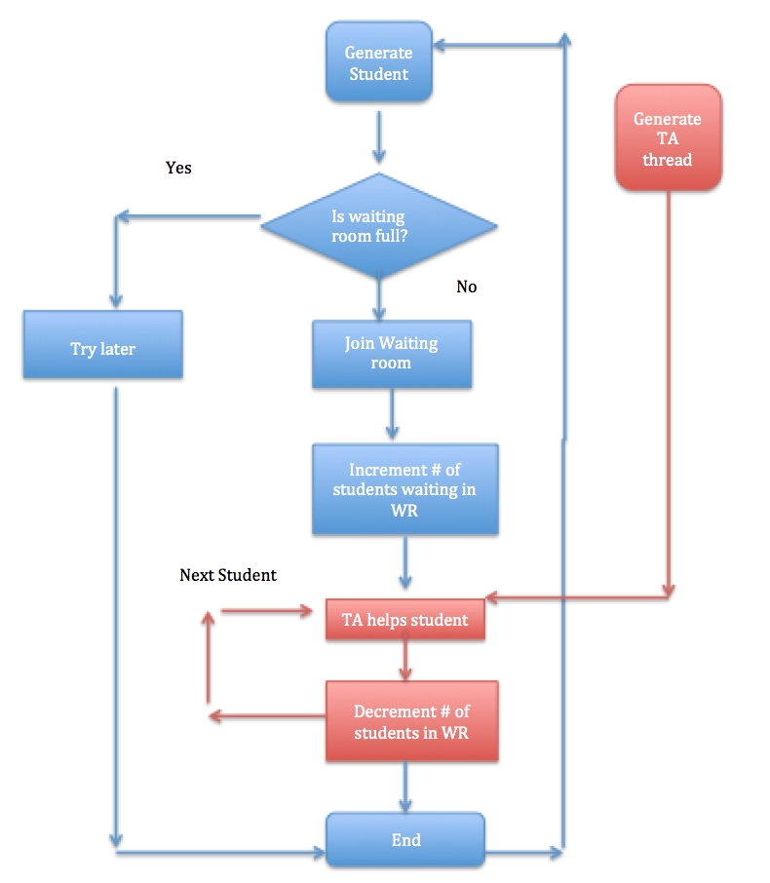
Flow Chart

Slide 10
Pseudo Code for Single TA
#define CHAIRS 5 /* # chairs for waiting students */
typedef int semaphore; /* declare semaphores*/
semaphore studentAvailable = 0; /* # of student waiting for help*/
semaphore taReady = 0; /* ta waiting for student*/
Semaphore waitingRoom = 1; /* for mutual exclusion of waiting room access*/
int studentsInWaitingRoom = 0; /* number of students waiting*/
void taRoutine(void)
{
while (TRUE)
{
wait (&studentAvalable); /* go to sleep if # of students is 0 */
wait (&waitingRoom); /* acquire access to "waiting room */
studentsInWaitingRoom = studentsInWaitingRoom -1;
/* decrement count of waiting students */
/*ta is helping student*/
signal (&taReady); /* ta is ready for next student*/
signal (&waitingRoom); /* release access to 'waiting’ room */
}
}

Slide 11
Pseudo Code for Single TA (Cont.)
void studentRoutine(void)
{
wait (&waitingRoom); /* enter critical region i.e access waiting room */
if (waiting < CHAIRS) /* if there are no free chairs, leave */
{
{studentsInWaitingRoom = studentsInWaitingRoom + 1;
/* increment count of waiting students*/
signal (&studentAvailable); /* wake up ta if necessary */
signal (&waitingRoom); /* release access to 'waiting' */
wait (&taReady); /* go to sleep if # of students waiting is 0 */
}
Else
{
signal (&waitingRoom); /* room is full; do not wait */
}
}

Slide 12
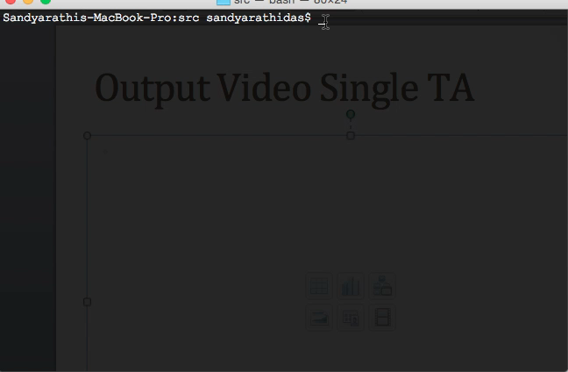
Output Video Single TA

Slide 13
Multiple Ta problem
Many students approach multiple TAs depending on the TA availability
A TA’s office room with m chairs + a computer + a waiting room with n chairs.
No students → all the TAs sleep.
All waiting room chairs are occupied → student leaves.
All TAs busy, chairs available → student waits.
All TAs available → students approach any TAs

Slide 14
Pseudo Code For Multiple TA
waiting_queue_size=9
semaphore ta_sem,student_sem,wait_sem; //declare semaphores
main()
{
//initialize semaphores
init(ta_sem,3);
init(student_sem,0);
int(wait_sem,1); //binary semaphore to synchronize access to waiting queue
pthread_t ta_id[3], student_id[13]; //ids for TA and Student threads
//create threads for TAs and Students
for(int i=1;i<=3;i++)
{
//create TA threads
pthread_create(ta_id[i],NULL,(void *)ta_function, (void*)&i);
}

Slide 15
Pseudo Code For Multiple TA (Cont. )
for(int j=1;j<=13;j++)
{
//create Student threads
pthread_create(student_id[i],NULL,(void *)student_function, (void*)&j);
}
//Joining the student threads
for(int k=1;k<=13;k++)
{
join(student_id[k]);
}
ta_function(void *i)
{
while(1)
{
wait(student_sem); //wait for a student "j" to approach
signal(ta_sem) //TA "i" gets ready to help student
}
}

Slide 16
Pseudo Code For Multiple TA (Cont. )
student_function(void *j)
{
wait(wait_sem); //getting access to modify the wait queue
if(waiting_queue_size>0)
{
waiting_queue_size--;
signal(wait_sem); //releasing the wait queue
signal(student_sem); //Student "j" approaches TA
wait(ta_sem) //wait for TA "i" to help
wait(wait_sem);
waiting_queue_size++;
signal(wait_sem); //releasing the wait queue
}
Else
{
signal(wait_sem);
//The wait queue is full hence release the wait queue. The student leaves and comes back later
}
}

Slide 17
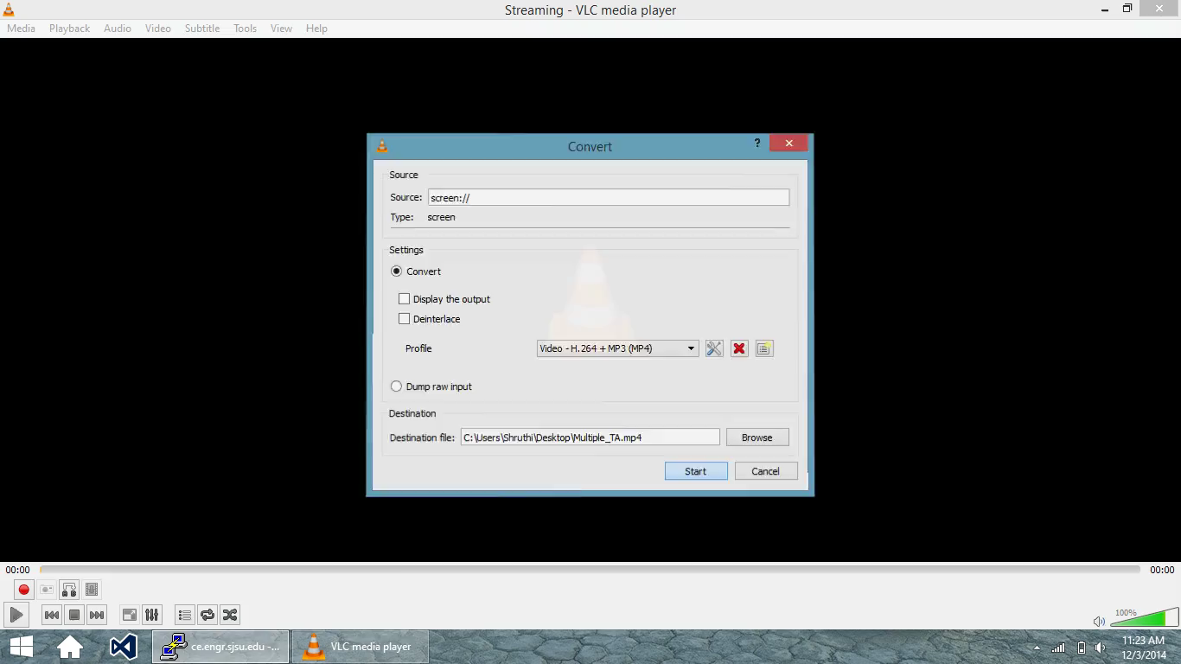
Output Video Multiple TA

Slide 18
Solution
POSIX threads, semaphores
Use of Pthreads
Create separate threads for a TA and n students
Student threads seeks help from TA, if available, else sit in a chair in the waiting room
If no chairs are available, will leave the place
Use of Semaphore
To notify the TA, arrival of the student in the room
TA monitors number of students in the waiting room
If no students are present, the TA may sleep.
Notes:
Use this as script..

Slide 19

THANK YOU!

